Slide 1
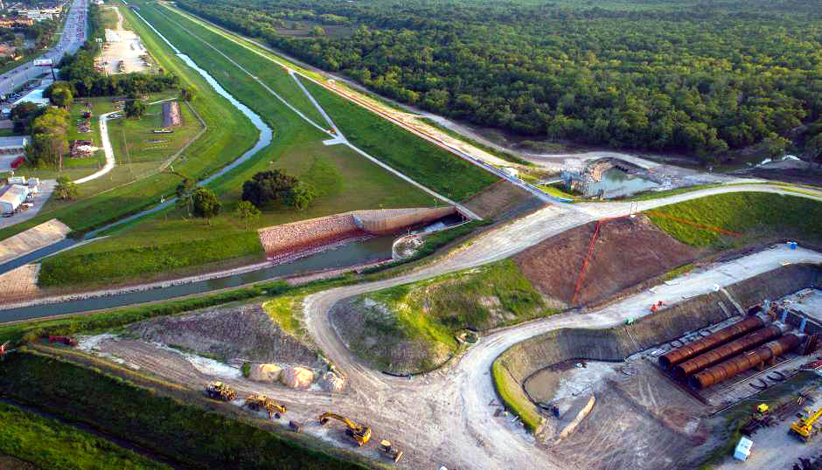
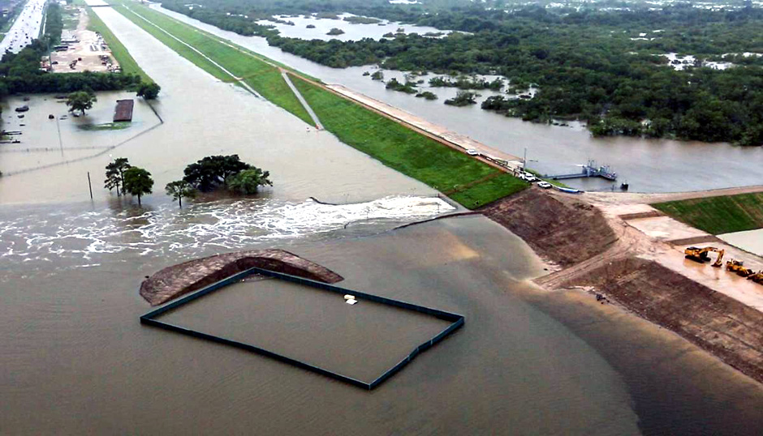
Upstream Flood Risk Reduction for Next Harvey
January 23, 2019
Data Science Project 1
Rice University - Houston, Texas
Lesly Bohuchot
Doug Newsom
Margret Saniel

Slide 2
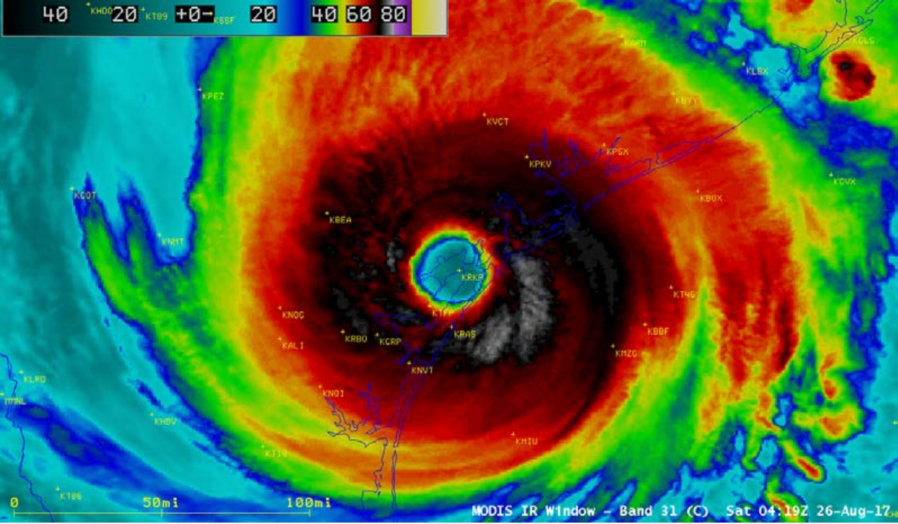

Slide 3
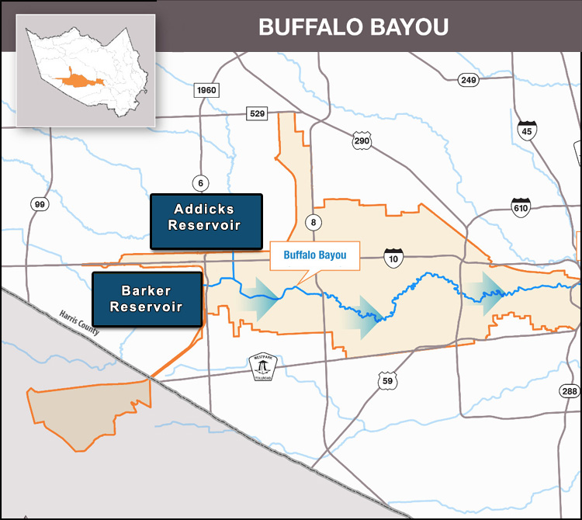
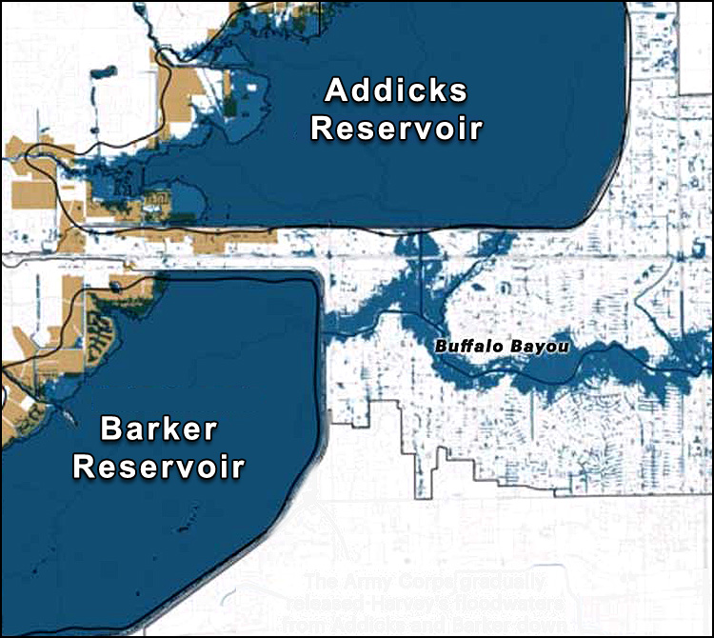
Buffalo Bayou Study Area

Slide 4
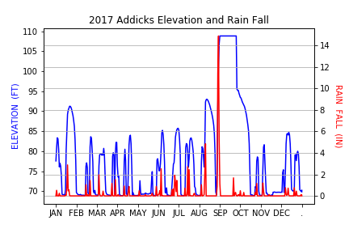
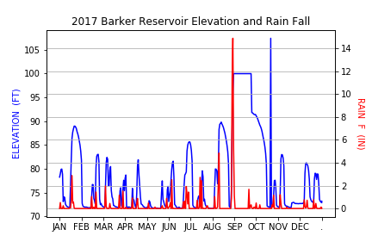
Reservoir Flooding

Slide 5
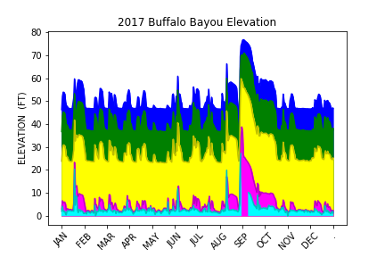
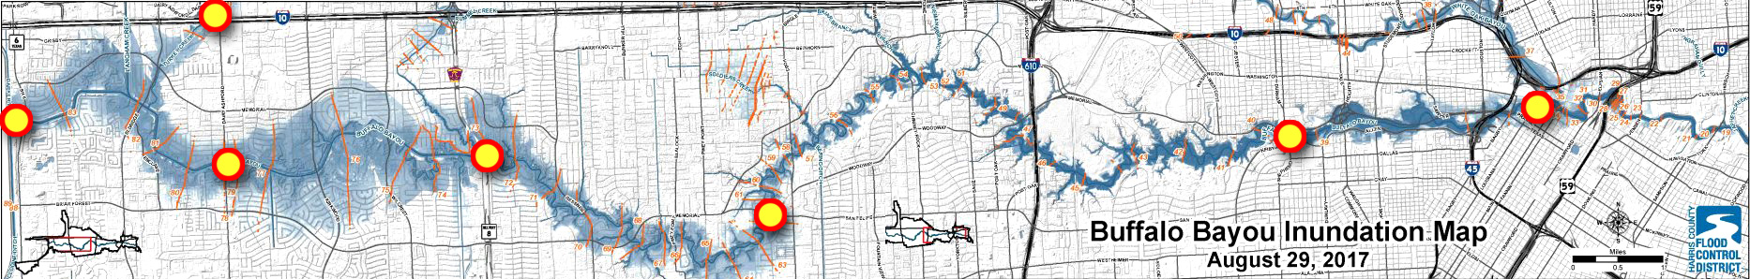
Buffalo Bayou Flood Monitoring

Slide 6
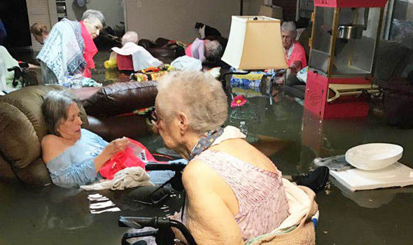
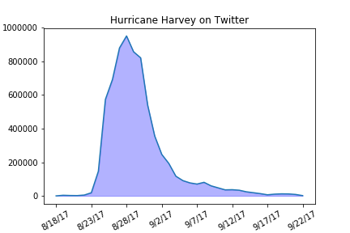
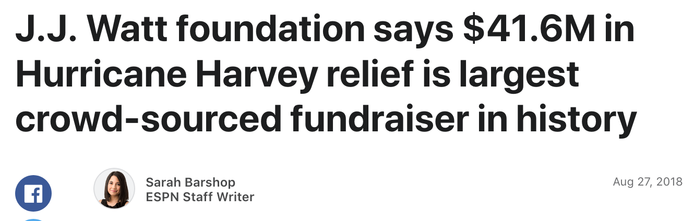
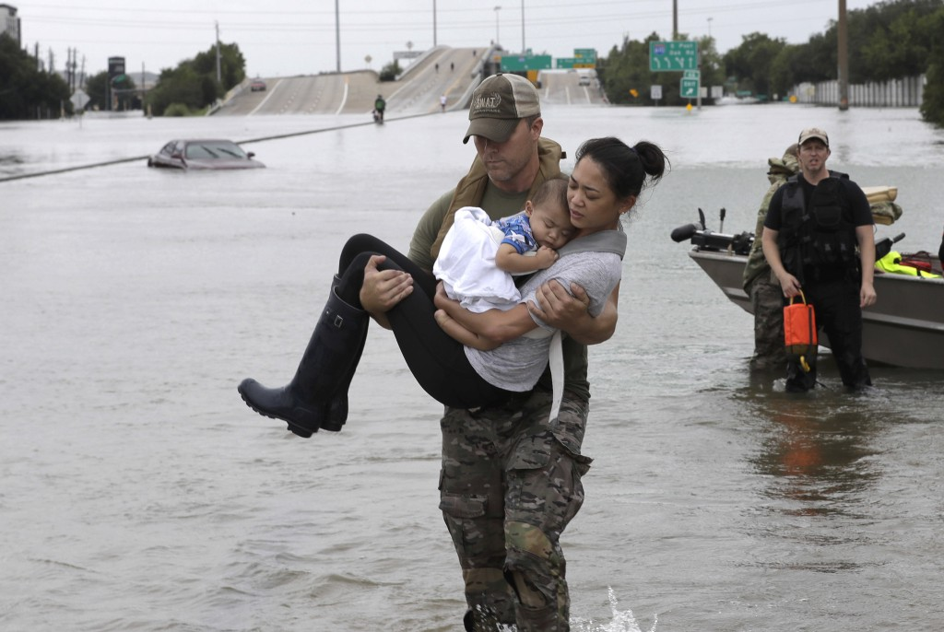
Hurricane Harvey on Social Media

Slide 7
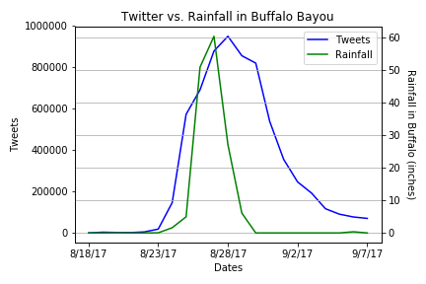
Buffalo Bayou and Twitter
Peak rainfall = 60.36 in
7M tweets total during Harvey

Slide 8
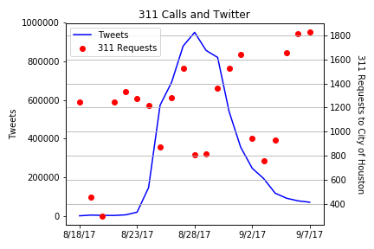
Service Requests and Social Media
50k requests sent in
+700 requests still open to date

Slide 9
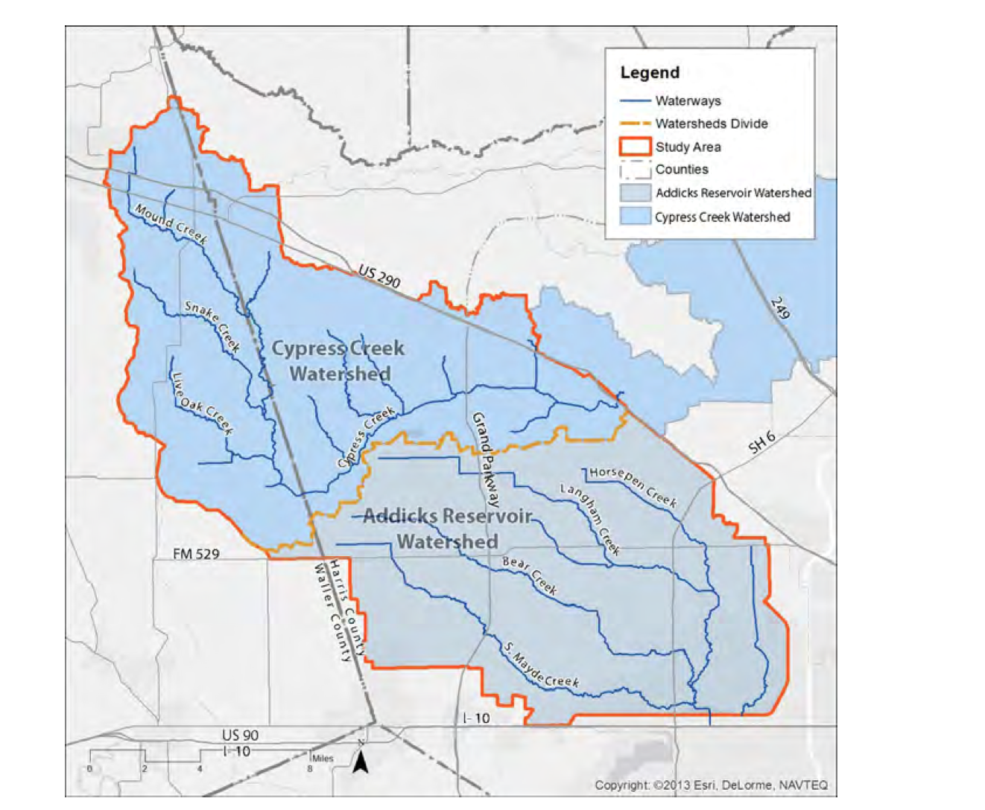
3rd reservoir Cypress Creek Watershed

Slide 10
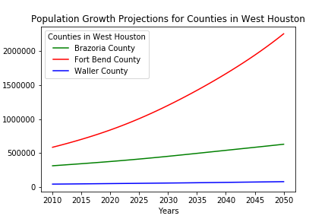
Population Growth Projection

Slide 11
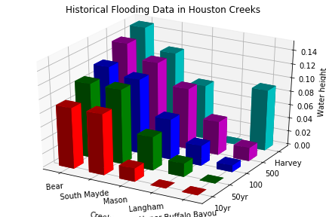
Flood Risk Probability
Add Plot Here

Slide 12
Conclusions
Addicks and Barker Reservoirs - Constant Threat
Future Buffalo Bayou Flooding - High Risk
Social Media - Utilize for emergencies
High population growth expected on West Houston
Flood levels from Harvey indicate a need to protect the incoming communities

